Slide 1





Billiards
Management
Program
C2312L - Group 1
Project 2 - Java

Slide 2




Team Members
Nguyễn Văn Hiếu
Nguyễn Việt Long
Lưu Minh Quân
Nguyễn Đức Mạnh

Slide 3

Contents
1. Project Purpose
2. Project’s Functions
Pool Tables Management
Orders Management
Order Details Management
Products Management
Users Management
Customers Management
Report Management
3. Database & ERD Diagram

Slide 4
Project Purpose
Provide comprehensive solution for billiard club management.
Help owners streamline the management process: managing pool tables, orders, products, and more.
Track revenue efficiently.
Enhance user experience.

Slide 5
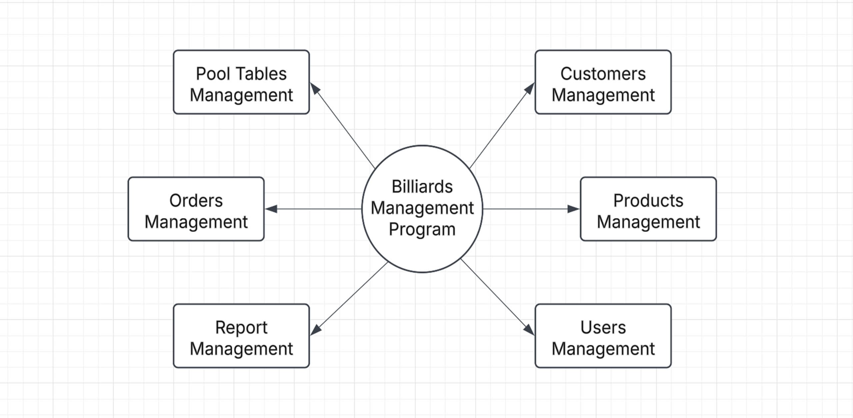
Program’s Functions

Slide 6
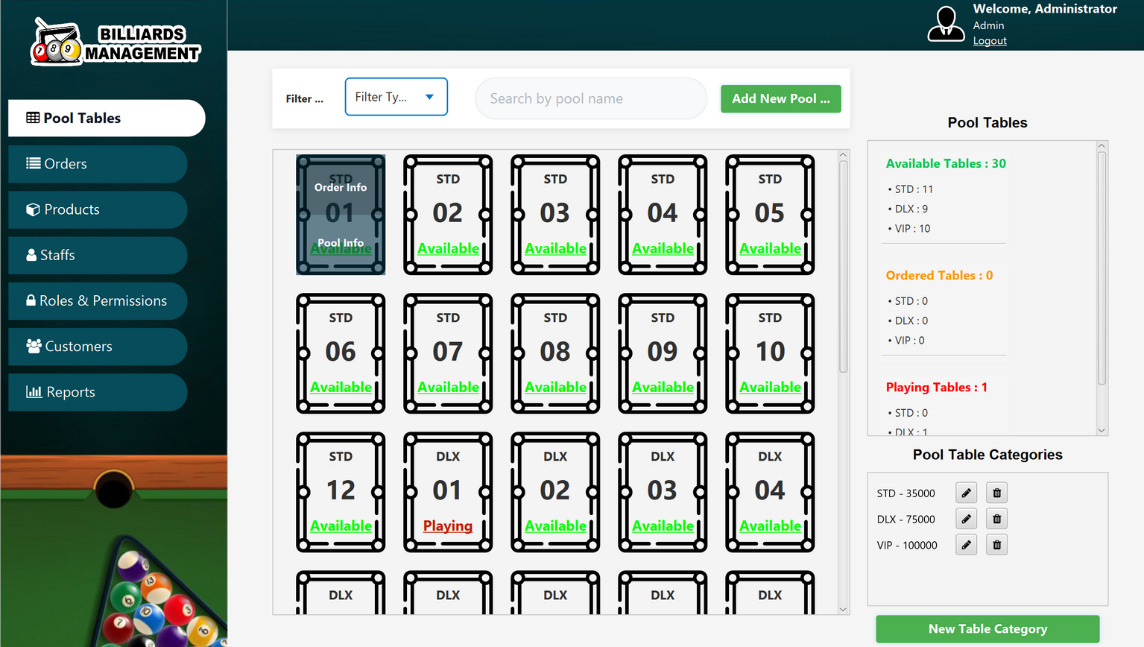
Function Pool Tables Management
Manage pool tables and orders with advanced filtering
Quick search
Create, update pool tables
Create and update pooltable categories

Slide 7
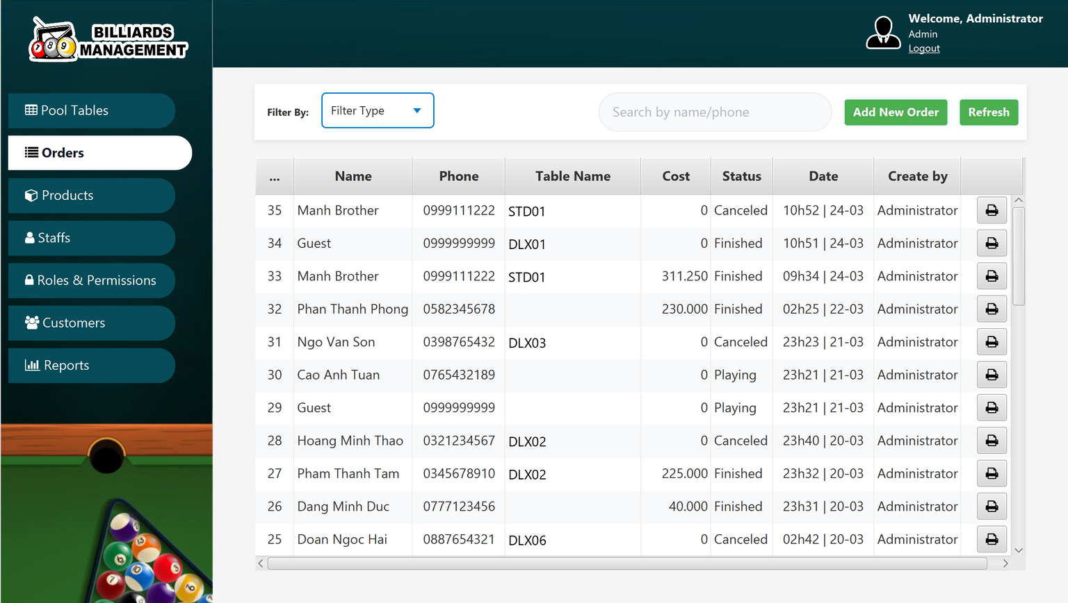
Function Orders Management
Display Orders table with advanced filtering options
Search Orders by name / phone
Add new Order
Print invoices

Slide 8
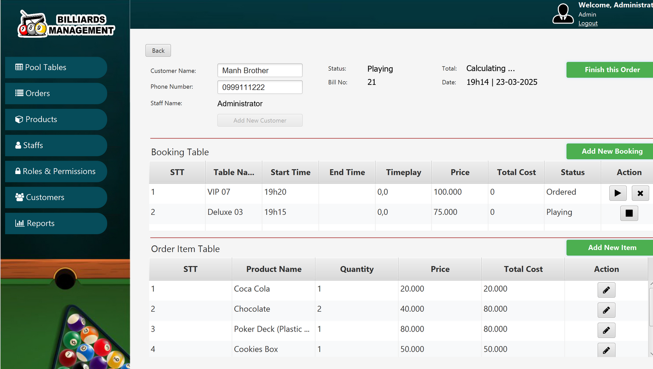
Function Order Details Management
Display Order Details view with necessary information
Manage Customer information
Add Booking, Order Item / Finish Order
Update / Remove Order Items
Change Status of
Booking Table

Slide 9
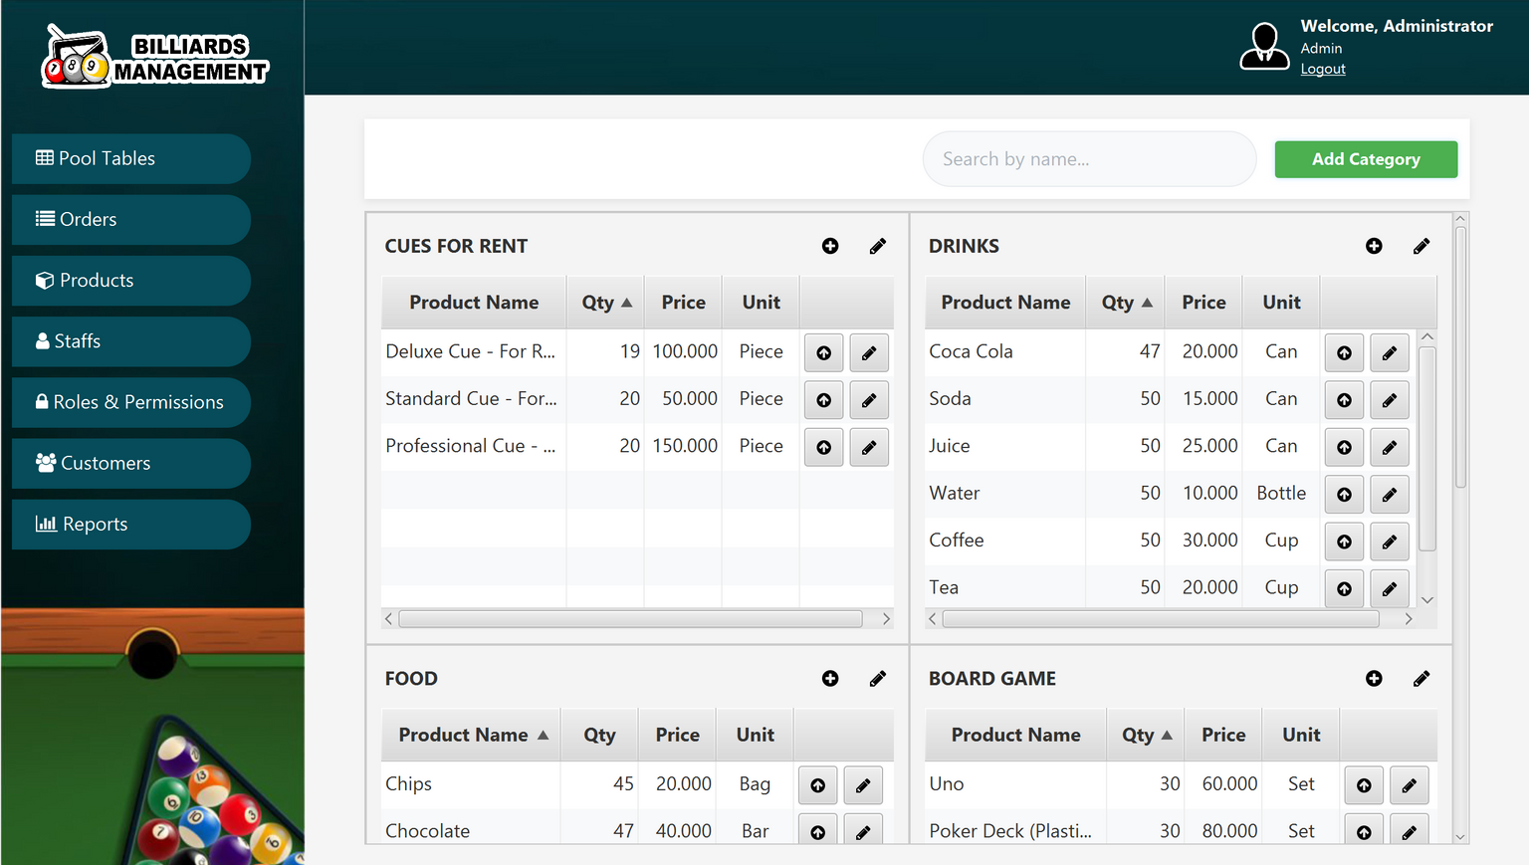
Function Products Management
Manage products list by each seperated category.
Search product
Create and update operations for products and categories

Slide 10
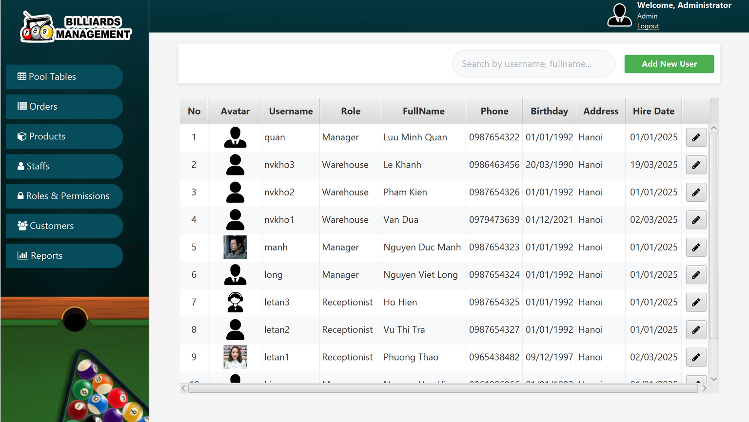
Function Users Management
Manage users information with create and update operations.
Search by Username / Fullname / Phone Number
Manage Role - Permission details with full CRUD operations

Slide 11
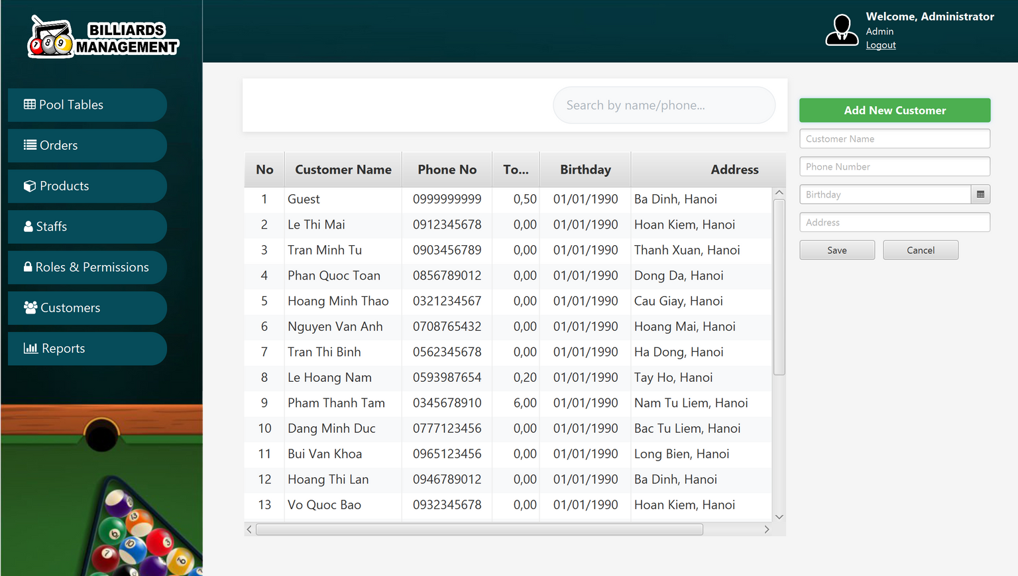
Function Customers Management
Manage customer’s account and perform create / update operations.
Search by Name / Phone Number
Display customer list with key details

Slide 12
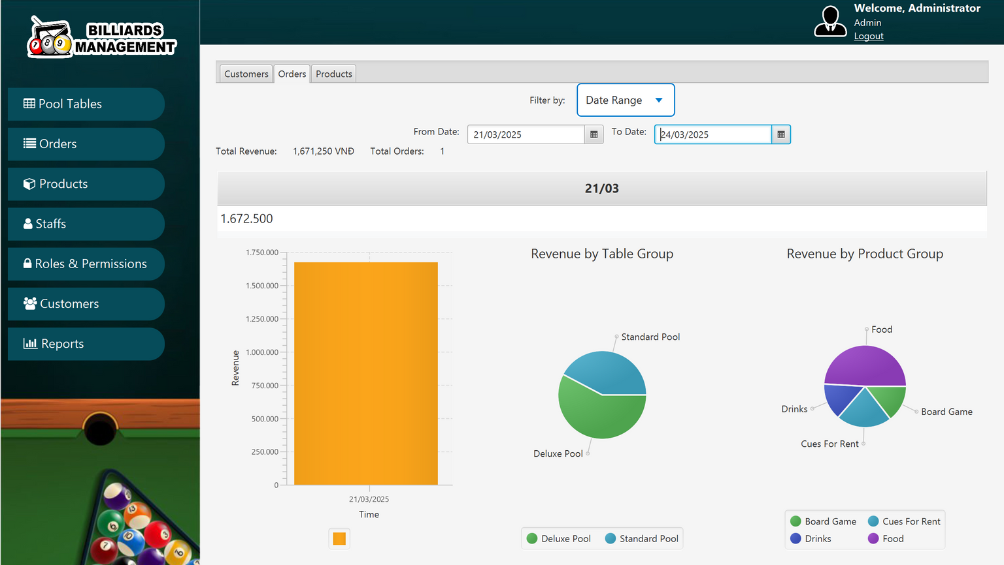
Function Report Management
Generate business reports for revenue, customer trends, popular services.
View revenue, customer, and product reports.
Generate reports in table, chart, or graph.
Apply filters and manage access.

Slide 13
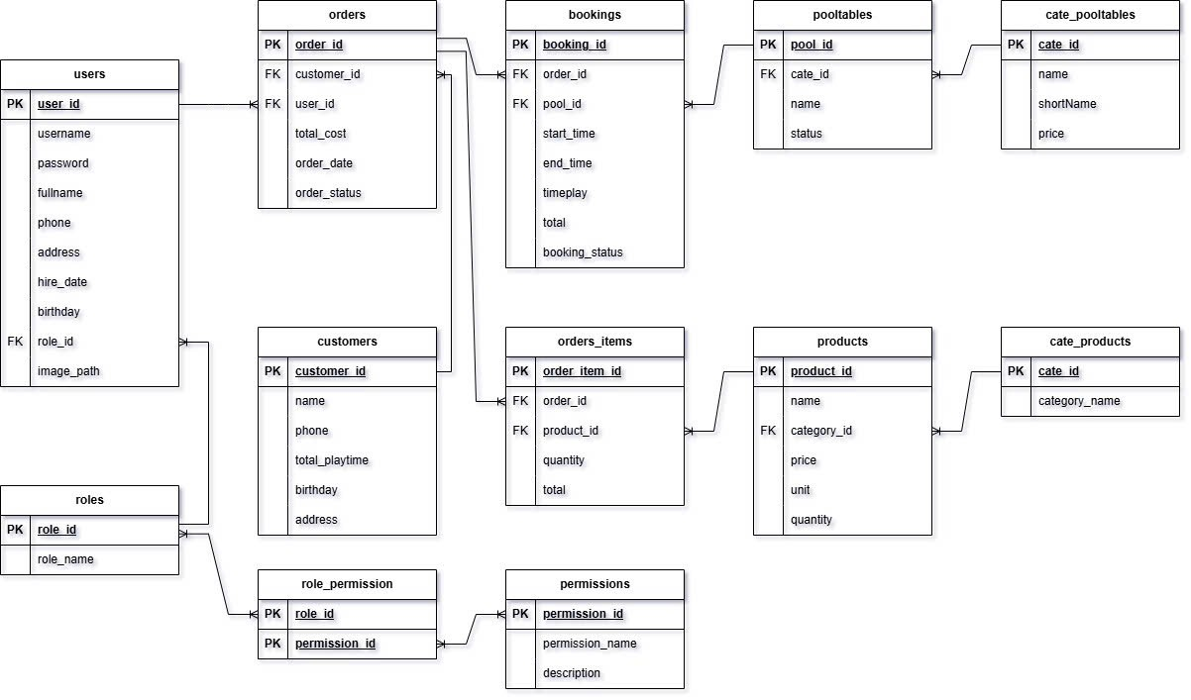
Database

Slide 14
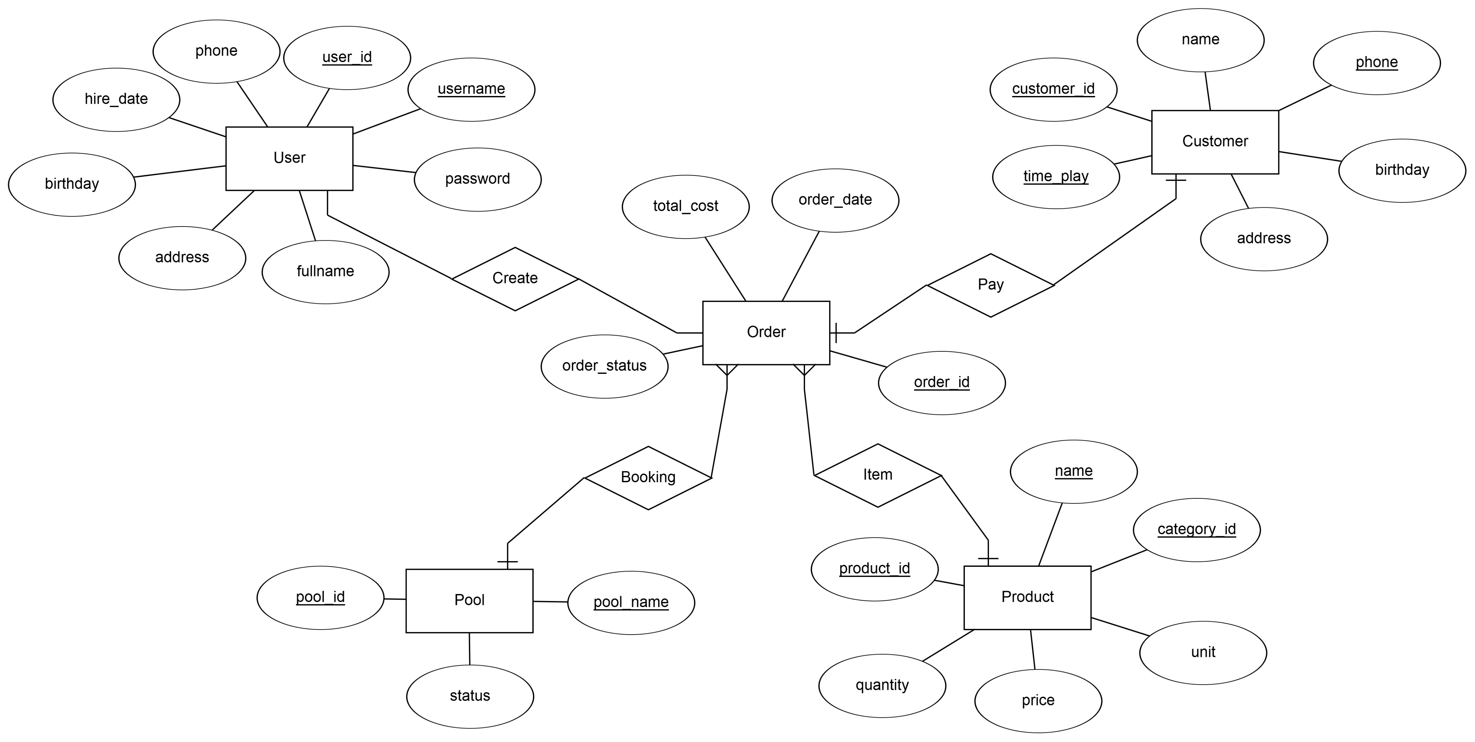
Entity Relationship Diagram

Slide 15













Thank you
for watching!
C2312L - Group1
Project2 - Java

